Slide 1

MENTOR-MENTEE TRAINING PLAN
PROCEDURE FOR NEW ENGINEERS
DATE: OCTOBER 04, 2017

Slide 2
INDEX
Purpose
Role and responsibility
Schedule
Training cycle & Definition of targeted engineer
Evaluation
Issue and Solution
Appendixes

Slide 3
1. PURPOSE OF MENTOR-MENTEE SYSTEM (MMS)
To accelerate improving new engineers’ skill systematically
To develop new engineers in both technical and soft skills.
To improve mentor’s soft skill (finding fact, evaluating, visualizing problems, consensus building, coaching …)

Slide 4

TRAINING SYSTEM AT RVC
Structured On-the-Job Training
The most important condition to become
an expert in the field
Mentor – Mentee training
Project Internal training
Project review – Quality review
MANAGEMENT SKILLS
Training Suites
Specific knowledge
PROJECT MANAGEMENT
Training
INTERMEDIATE
Renesas Technical
PRACTICAL
Training
PROJECT
Internal Training
Mentor - Mentee
Training
Effective
in Work
WORK at
a Company
BASIC
Renesas Technical
Training for
New Engineers
2 months
6 months
1 year
3 years
7 years
Seniority
(logarithmic scale)
© 2010 Renesas Design Vietnam Co., Ltd. All rights reserved.

Slide 5
2. ROLE & RESPONSIBILITY
 | Role | Responsibility
HR | Organizer | - Organize the plan and follow up MMS for all fresh engineers systematically. - Collect the suggestion and feedback from Mentors and Mentees and Engineering Division to improve this system. - Collect and record the result from MMS for MBO and appraisal and evaluation the improve in quality of engineers. - Evaluate and feedback to managers for improvement
Department/ Section/Group | Evaluator Host in presentation days | - Define the overall standard and target for each Department/ Section/Group - Approve the MM program - Evaluate the result of MMS on each stage. - Apply result of MMS for MBO/Appraisal - Verify and modify the content of MMS to be suitable with the development of company. - Improve MMS
Mentor | Instructor | - Define target and detail training content for Mentee - Follow up and coach Mentee during MMS - Report, evaluate the Mentee & program monthly or quarterly to Managers - Improve MMS
Mentee | PIC | - Discuss with Mentor to define target for MMS - Follow the training plan - Report the result to Mentor monthly or quarterly - Give feedback to improve MMS

Slide 6
3. PLAN SCHEDULE
< Standard Cycle Schedule >
Start Mentor/Mentee
Mid term
Presentation
Finish
Mentor/Mentee
Final
Presentation
Evaluation & Feedback
Employed
First Presentation
Training
(←Month)
M1 (Mar./ Sep.)
M2 (Apr./ Oct.)
M4 (Jun./ Dec.)
M13 (Apr./Oct.)
M24 (Apr./ Oct.)
M25 (Apr./ Oct.)
M25 (Apr./ Oct.)
Note:
If Mentee is assigned into new group during MMS, the Group Leader should assign new Mentor and review training program immediately to catch up with new business requirement.
Mentors should have the high technical skills and good attitude. Mentees can not be assigned as Mentors if they have uncompleted their Mentor-Mentee training.
In case the Mentor resigns, the Group Leader should assign new Mentor immediately to ensure the quality of MMS and The current Mentor has to transfer all information of MMS to the new Mentor before last working day.
If Mentee has submitted resignation letter, the MMS will be closed automatically

Slide 7
PRESENTATION SCHEDULE
First Presentation (at 4th month from joining RVC)
(1) HR announces start of Mentor/Mentee after the group assignment.
(2) Eng. Div. decides assignment of Mentor.
(3) Mentor/Mentee decides target and training center curriculum.
(4) Mentor register target and curriculum in common record.
(5) HR organizes the presentation and Mentee gives presentation.
2. Mid term Presentation (before 13th month from joining RVC)
(1) HR announces the mid term presentation.
(2) HR organizes the presentation and Mentee gives presentation.
(3) Group Leader evaluates performance of Mentor and Mentee.
(4) Manager reviews the evaluation of Solid line manager and sends to HR
(5) Group Leader and above give feedback to Mentor and Mentee.
3. Final Presentation (before 25th month from joining RVC)
(1) HR announces the final presentation.
(2) HR organizes the presentation and Mentee gives presentation.
(3) Group Leader evaluates performance of Mentor and Mentee.
(4) Manager reviews the evaluation of Solid line manager and sends to HR
(5) Group Leader and above give feedback to Mentor and Mentee.
(Note: Standard time duration of presentation is 10 min. for presentation and 5 min. for Q&A. However, it can be altered depending on number of Mentees.)

Slide 8
PRESENTATION REQUIREMENT
1. First Presentation (at 4th month from joining RVC)
Set target and estimate achievement in advance
Make plan both PJ and training schedule
Analyze difficulties and solutions
2. Mid term Presentation (before 13th month from joining RVC)
Report the result compare with original target
Activities and achievement
Next plan
Difficulties and solutions if any
Feedback for improvement if any
3. Final Presentation (before 25th month from joining RVC)
Report MM target and result
Activities and achievement
Difficulties and solutions
Feedback for improvement if any
Next plan if any

Slide 9
PRESENTATION PROCEDURE
In a mentor-mentee presentation meeting:
Host: Group Leader and above
Time for presenting: 15 minutes per person (10 minutes in the first Presentation meeting) including presenting and QA.
Mentors need to give the comment (from 30 seconds to 1 minute) about target of Mentees for the First presentation, review the target or result of Mentees in the Midterm/Final presentation, or comment about the Mentor-Mentee system, challenges or proposal if any.

Slide 10
4. Training Cycle
Coach
Support
Encourage
Gap.
Gap.
Gap.
Skill level
Job Difficulties
Overcoming this gap makes engineers more capable, skillful and productive.

Slide 11
Training Cycle
P
A
Job Assignment
proper job to your mentee
with appropriate difficulties.
Higher job Assignment
to your mentee with more difficulties.
Encourage,
Support and Coach
your mentee to achieve the task.
D
C
Evaluate, Analyze
and Recognize
your mentee’s achievement
and capability.
Only the high level job assignment
makes engineers be skillful.

Slide 12
Require and Gain
Phase | Requirement | Need to do | You can gain
<Planning Phase> Job assignment | With proper difficulties. “Proper” means that mentee can overcome within PJ schedule with your coaching. | To find facts (mentee’s level, job level) To manage both PJ and training schedule. To set target and estimate achievement in advance. | Finding fact Schedule management Making accurate estimation Sharing target
<Doing Phase> Encourage, Support, Coach, Suggest | A piece of instructive advice. Don’t give solutions. Give the chance of “aha!-moment” | Let mentee think about and find solutions by himself, at least let him propose options. To point out and reinforce his weak-point. | Effective coaching Visualizing problems
<Checking Phase> Evaluate mentee’s ability | Fair and accurate evaluation based on achievement. Proper feed back | To find facts and compare estimation (expectation) and result (improvement). | Evaluating Giving feed back logically
<Action Phase> Higher job assignment | With proper difficulties. “Proper” means “more challenging” than before. | To explain evaluation result and make next plan on common ground with mentee. To build consensus with mentee. | Making common ground Building consensus Accountability

Slide 13
DEFINITION OF TARGETED ENGINEER BY ENGINEERING DIVISION
Experience | Over all Image of Character | Technical Ability | Management Ability | Communication Ability | TOEIC
1 Year Later | Can do basic work under supervisor’s instruction | It should be defined by Department as following pages | Can keep assigned schedule | Can report his problem to supervisor | -
2 Year Later | Can do feedback by looking at result of work |  | Can keep schedule and raise alarm if necessary | Can report work status in his team | -
3 Year Later | Can instruct younger engineers in his responsible segment |  | Can estimate schedule, and can make action to keep schedule | Can report problem in group, and can negotiate with group member | 650

Slide 14
HARDWARE (1/2: FE)
Expected Level of engineers
  2-Year old engineers are expected to obtain skills below at level where he/she can complete task without help.
Category | Frontend Design
 | Functional Design | Functional Verification
Execution of Design & Verification | to create RTL level functional description and module connection with HDL | to list verification items based on product specifications and chip specifications
 | to describe timing constraints for chip and/or module levels | to create test patterns covering verification items using HDL and assertions
 | to check RTL description using RTL checker and modify if errors are found | to conduct verification by using logic simulator with test patterns, judge results and modify input data if necessary
 | to conduct synthesis with associated tool and retry synthesis with alteration of synthesis options and/or modification of RTL/SDC to meet specified criteria | to conduct verification coverage collection
Evaluation of Design & Verification result | to check assignment proceeds as scheduled | to check assignment proceeds as scheduled
 | to check design met given specification and modify it if necessary | to judge verification items are covered by test cases and evaluate coverage result
 | to summarize design information and constraints and provide them to DFT and layout designer | to summarize verification results and report
Remarks : Individual targeted skill should be defined by Mentor/Mentee and MBO

Slide 15
HARDWARE (2/2: BE)
Expected Level of engineers
  2-Year old engineers are expected to obtain skills below at level where he/she can complete task without help.
Category | Backend Design
 | Layout Design & STA | DFT
Execution of Design & Verification | to create floor-plan considering signal timing, chip size, wiring density, power constraints and hard-macro constraints | to insert Mux SCAN chain, logic BIST, memory BIST, boundary and IDDQ test scan into netlist with associated tool
 | to determine bonding PAD allocations on LSI die conforming to bonding rules | to check logic equivalence between before and after of DFT insertion with associated tool and provide feedback if necessary
 | to create chip layout based including power/ground network, CTS, Place & Route, considering timing and signal integrity | to create test patterns for SCAN and functional tests with associated tool and provide feedback if failure detection rate does not meet criteria
 | to carry out signal routing improvement according to STA output | to create patterns for defective memory replacement and conduct verifying memory rescue patterns
Evaluation of Design & Verification result | to check assignment proceeds as scheduled | to check assignment proceeds as scheduled
 | to verify if the chip-implementation conforms to the guidelines and specifications | to verify design and tests are met to test strategy of product
 | to summarize layout results and report | to summarize DFT results and report
Remarks : Individual targeted skill should be defined by Mentor/Mentee and MBO

Slide 16
MINIMUM SKILL/ROLE (TWO YEARS LATER)
Expected Level of engineers
Software
 | Verification/Failure analysis | Programming | MCU architecture | Operating System | Development Process | QC in software | Project Management
Software design engineer (Function/Detail spec) role level 2 | Can do feedback by looking at result of work | Can do feedback by looking at result of work | Can understand architecture of objective MCU of assigned product | Can understand objective OS of assigned product | Can do feedback by looking at result of work | Can do basic work under supervisor’s instruction | Can do basic work under supervisor’s instruction
Coding engineer (Software) role level 2 | Can do feedback by looking at result of work | Can do feedback by looking at result of work | Can understand architecture of objective MCU of assigned product | Can understand objective OS of assigned product | Can do feedback by looking at result of work | － | －
Verification/System testing engineer role level 2 | Can do feedback by looking at result of work | － | Can understand architecture of objective MCU of assigned product | Can understand objective OS of assigned product | Can do feedback by looking at result of work | － | －
Skill
Role
Remarks : Individual targeted skill should be defined by Mentor/Mentee and MBO

Slide 17
5. EVALUATION METHOD
< Evaluation Format >
Group Leader evaluates and Manager examines the result.
Evaluation point is described in the same way as appraisal (5=Outstand <-> 1=Need to improve: by absolute evaluation, not relative evaluation)
Role | Evaluation item |  | Criteria to evaluate
Mentee | A | Technical skill | Acquired designated technical skill, knowledge required by the standard definition of mentee to perform the expected job level.
 | B | Communication ability and team work | Acquired proper communication skill to report to supervisor for feed back and alarm for problem solving, and have team work attitude for cooperation with colleagues.
 | C | Motivation | Maintained high motivation with commitment to achieve mission and keen enthusiasm for challenging spirit for better result.
 | D | Customer satisfaction | Maintained attitude to mind customer satisfaction and improvement of quality of work and productivity
 | E | Education and Training | Attended designated training curriculum and performed qualification in result of training to obtain knowledge.
Mentor | A | Communication | Mainained enough frequent opportunity of contact and monitoerd situation of mentee's progress regularly and carefully.
 | B | Coaching | Whether listened sincerely issues of mentee and provided proper suggestion timely to let him discover solution by himself.
 | C | Technical development | Whether provide enough and timely technical advice and monitor progress of mentee's technical improvement.

Slide 18
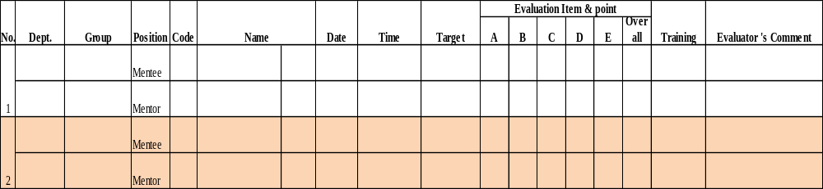
EVALUATION FORM

Slide 19
RENESAS DESIGN VIETNAM

Slide 20
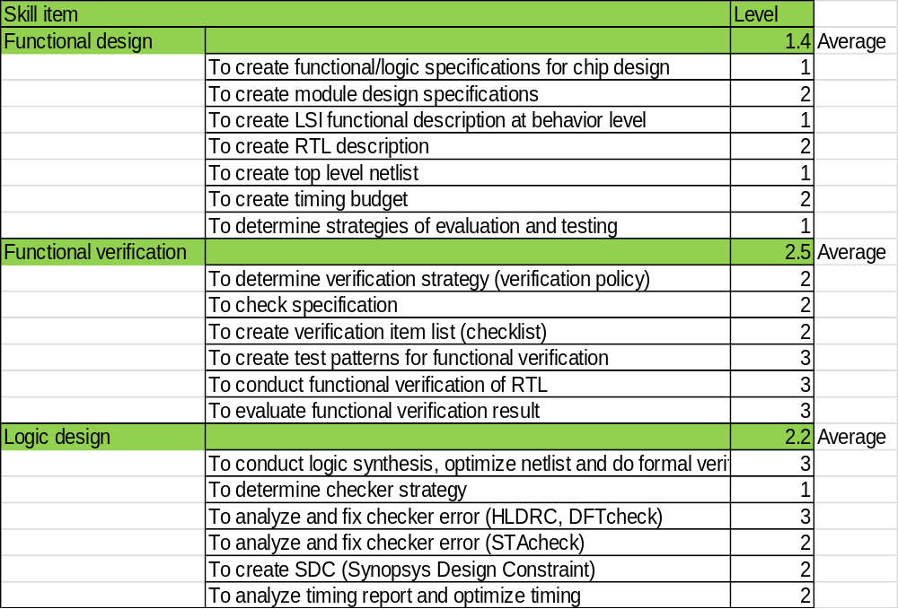
GUIDELINE OF TARGET SKILL LEVEL
FOR HARDWARE SOLUTION, SYSTEM CORE&IP SOLUTION SECTION

Slide 21
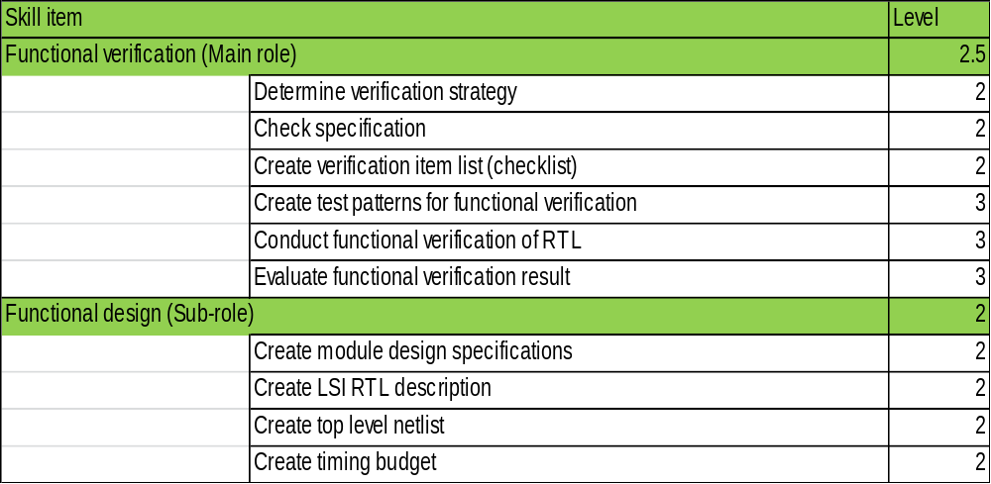
GUIDELINE OF TARGET SKILL LEVEL
FOR MCU CORE & IP SOLUTION, MCU SOLUTION 1/2 SECTIONS
Page <number>

Slide 22
GUIDELINE OF TARGET SKILL LEVEL
FOR BACKEND SECTION
Must achieve level 3 for technical skill (at least one technical area as minimum)
Must join and complete assigned task for 2 Tape out products
Mature other skills beside technical : report, document, communication, ..

Slide 23
GUIDELINE OF TARGET SKILL LEVEL
FOR MIDDLEEND (DFT)
ME standard skill target
Created by: TrucNguyen
Revision: 2015 Jul/29
 |  |  |  |  |  |  | Target for Mentor-Mentee
Standard skill map for DFT engineer |  |  |  |  |  |  | 1-year |  | 2-year
No. | Field | Skill |  |  |  |  | MB Eng | SCAN Eng | MB Eng | SCAN Eng | Note
1 | BSD | Can do BSD insertion |  |  |  |  |  |  |  | 2 | Can choose BSD or SDC
2 |  | Can do BSD verification & make tester pattern |  |  |  |  |  |  |  | 2
3 | MBIST | Can do MBIST insertion |  |  |  |  | 2 |  | 3
4 |  | Can do MBIST verification |  |  |  |  | 2 |  | 3
5 |  | Can make MBIST tester pattern |  |  |  |  | 2 |  | 3
6 |  | Can make special pattern (AC-merge, FBM,…) |  |  |  |  | 2 |  | 3
7 |  | Can ROMBIST insertion & verification (for flash memory) |  |  |  |  | 2 |  | 3
8 |  | Can do RAM grouping considering routing, timing, power, test-time. |  |  |  |  | 2 |  | 3
9 |  | Do & optimize fusebit assignment to get best RAM-repair efficiency |  |  |  |  | 2 |  | 3
10 | SCAN | Can do SCAN/LBIST insertion |  |  |  |  |  | 2 |  | 3
11 |  | Can do DFT/SCAN grouping considering routing, timing, power, test-time. |  |  |  |  |  | 2 |  | 3
12 |  | Can do SCAN/LBIST verification & make tester pattern |  |  |  |  |  | 2 |  | 3
13 |  | Can analyze coverage result & give solution to improve it (such as: TPI analysis & decide TPI insertion configuration) |  |  |  |  |  | 2 |  | 3
14 |  | Can generate IDDQ pattern (bridge fault, stuck at fault) & obtain coverage |  |  |  |  |  | 2 |  | 3
15 |  | Can obtain toggle rate of Burn-in pattern. |  |  |  |  |  | 2 |  | 3
16 |  | Can generate path-delay pattern (to check critical path) |  |  |  |  |  | 2 |  | 3
17 | SDC | Make DFT mode SDC |  |  |  |  |  |  | 2 |  | Can choose BSD or SDC
18 |  | Can make judgement for timing path in DFT mode |  |  |  |  |  |  | 2
19 |  | Can do accuracy check (GCA, warning, Error judgement) |  |  |  |  |  |  | 2
20 | General | Can make DFT strategy (method, flow, circuit structure, circuit configuration,...) considering test time, test cost, area overhead, and routing/timing effect based on design feature & direction. |  |  |  |  |  |  | 2 | 2
21 |  | Can make DFT clean netlist (if necessary) |  |  |  |  | 2 | 2 | 2 | 2
22 |  | Can do Test-cost estimation & test-cost calculation. |  |  |  |  |  |  |  | 2
23 |  | Can do Formal verification (build env, check result, failure debug) |  |  |  |  | 2 | 2 | 2 | 2
24 |  | Can do Synthesis considering power, area, timing. |  |  |  |  | 2 | 2 | 2 | 2
25 |  | Can do SDF simulation |  |  |  |  |  |  | 2 | 2
 | Prj/Task Management | Can keep assigned schedule, and rise alarm if necessary |  |  |  |  | 2 | 2 | 3 | 3
26 |  | Can make project plan (scope, target, schedule, input-output, resource)
27 |  | Can define input/output criteria for each design phase |  |  |  |  | 2 | 2 | 2 | 2
28 |  | Can do risk assessment(identify the risk & make countermeasure, ex. method: DRBFM,…) |  |  |  |  |  | 2 | 2 | 2
29 |  | Can monitor & control project work |  |  |  |  | 2 | 2 | 2 | 2
30 |  | Can follow design procedure (make/apply checklist, do review, get approve before releasing) to guarantee output quality |  |  |  |  | 2 | 2 | 3 | 3
31 |  | Can make detail project schedule, including discuss schedule with related groups
32 |  | Can do project Lesson Learn & PDCA |  |  |  |  | 2 | 2 | 2 | 2
33 | Others | Can check wire congestion (using Amateras) |  |  |  |  | 2 | 2 | 3 | 3
34 |  | Can make plan to proceed the task (what to do, target, milestone, how to do) |  |  |  |  | 2 | 2 | 2 | 2
35 |  | Can make the report (prj report, weekly report,…) |  |  |  |  | 2 | 2 | 3 | 3
36 |  | Can make the document |  |  |  |  | 2 | 2 | 3 | 3
37 |  | Can do QC issue analysis (include PDCA) |  |  |  |  | 2 | 2 | 2 | 2
38 |  | Can use scripting lanquage (TCL, SCH, PERL, AWK, SED,…) |  |  |  |  | 2 | 2 | 3 | 3

Slide 24
GUIDELINE OF TARGET SKILL LEVEL
FOR MIDDLEEND (STA)
ME standard skill target
Created by: TrucNguyen
Revision: 2015 Jul/15
Standard skill map for STA engineer |  |  |  |  |  |  | Target for Mentor-Mentee
No. | Field | Skill |  |  |  |  | 1-year | 2-year | Note
1 | Technical | Build & control STA env |  |  |  |  | 2 | 2
2 |  | Do timing analysis (identify problem, make countermeasure) |  |  |  |  | 2 | 2
3 |  | Make DFT mode SDC (from spec) |  |  |  |  |  |  | One of USER or DFT SDC is OK.
4 |  | Make User mode SDC (from spec + individual constraints) |  |  |  |  |  | 2
5 |  | Do timing closure (setup & hold) |  |  |  |  | 2 | 3
6 |  | Conduct Kobetsu/AC timing check & closure |  |  |  |  | 2 | 2
7 |  | Contact SDC accuracy check (GCA, warning, Error) |  |  |  |  | 2 | 3
8 | Prj/Task Management | Can keep assigned schedule, and rise alarm if necessary |  |  |  |  | 2 | 3
 |  | Can make project plan (scope, target, schedule, input-output, resource)
9 |  | Can define input/output criteria for each design phase |  |  |  |  | 2 | 2
10 |  | Can do risk assessment(identify the risk & make countermeasure, ex. method: DRBFM,…) |  |  |  |  |  | 2
11 |  | Can monitor & control project work |  |  |  |  | 2 | 2
12 |  | Can follow design procedure (make/apply checklist, do review, get approve before releasing) to guarantee output quality |  |  |  |  | 2 | 3
13 |  | Can make detail project schedule, including discuss schedule with related groups
14 |  | Can do project Lesson Learn & PDCA |  |  |  |  | 2 | 2
15 | Others | Can make plan to proceed the task (what to do, target, milestone, how to do) |  |  |  |  | 2 | 3
16 |  | Can make the report (prj report, weekly report,…) |  |  |  |  | 2 | 2
17 |  | Can make the document |  |  |  |  | 2 | 3
18 |  | Can do QC issue analysis (include PDCA) |  |  |  |  | 2 | 3
19 |  | Can use scripting lanquage (TCL, SCH, PERL, AWK, SED,…) |  |  |  |  | 2 | 2

Slide 25
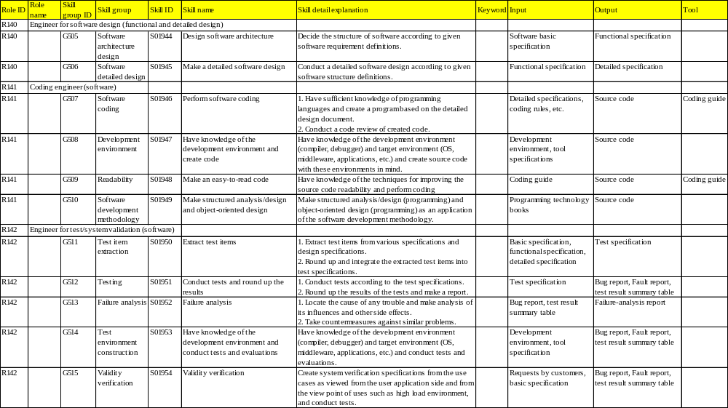
GUIDELINE OF TARGET SKILL LEVEL
FOR SOFTWARE SOLUTION 1 AND 3

Slide 26
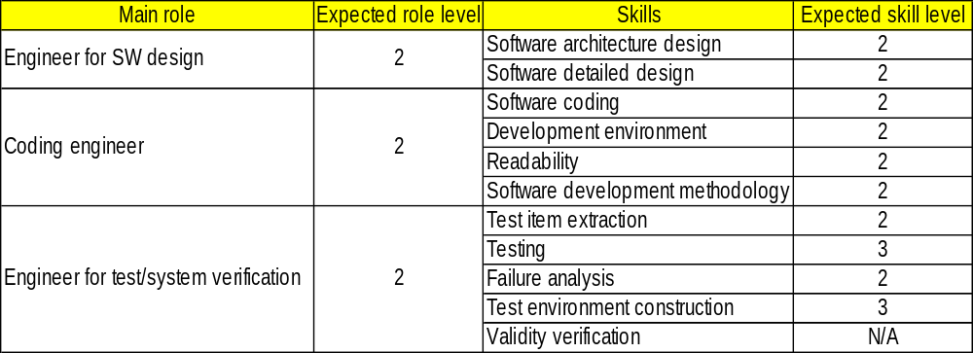
GUIDELINE OF TARGET SKILL LEVEL
FOR SOFTWARE SOLUTION 2
Details of technical requirements

